Slide 1


Term Project Presentation
Sentiment Analysis
Emotion Detection from Text
https://www.kaggle.com/datasets/pashupatigupta/emotion-detection-from-text
DSCI-521 Summer 2022 Drexel University CCI
Group 2:
Mangesh Raut. mbr63@drexel.edu,
Josh Clark. jc4577@drexel.edu,
Mobin Rahimi. mr3596@drexel.edu,
Will Wu. ww437@drexel.edu.
Prof. Milad Toutounchian. mt3393@drexel.edu

Slide 2

Introduction
What is emotion?
Emotions are mental states brought on by neurophysiological changes, variously associated with thoughts, feelings, behavioral responses, and a degree of pleasure or displeasure.
Types of Emotions: Worry, Happiness, Sadness, Love, Surprise, Fun, Relief, Hate, Empty, Enthusiasm, Boredom, Anger.
Speech, facial expressions, and text-based emotions are all ways that people can express their feelings. Text messages are a popular form of communication. Humans can quickly discern emotions, while machines have a harder time. For machines to discern emotions in text, algorithms must be precise. For psychologists, text-based recognition is also helpful.

Slide 3

Context, Content, Inspiration
One of the difficult issues in natural language processing is emotion recognition from text. The lack of labeled datasets and the multi-class nature of the issue are the causes. Since there are many different human emotions, it is challenging to compile adequate data for each emotion, which leads to the issue of class imbalance. The goal of using labeled data for emotion identification is to create a model that can effectively identify emotions.
The information is essentially a collection of tweets that have had the emotions they expressed annotated. The tweet id, emotion, and content columns are all present. We have the raw tweet under "content." The sentiment of a tweet reflects the sentiment behind it. For further details, consult the beginning notebook.
Thirteen different emotions, totaling over 40,000 records, are present in the data we have. Therefore, creating a multiclass classification model that is effective is difficult. In order to develop an effective model, we might need to logically minimize the number of classes and employ some cutting-edge techniques.

Slide 4
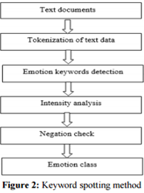
Keyword Based
Simple and Easy method Find Specific word in the sentence Work on Three dimension
Evaluation: this show how much a word is closed to happy or sad
Potency: show strong and weak intensity of word
Activity: show passive or active activity of the sentence
This technique takes text as input and, in the next step, performs tokenization on the input text. Emotional words are identified in the next step; afterwards, an analysis of the intensity of emotional words is performed.

Slide 5


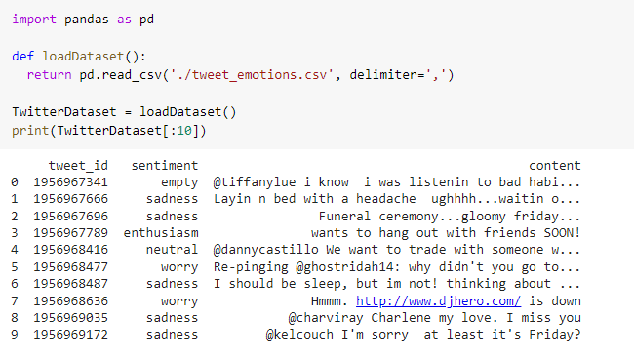
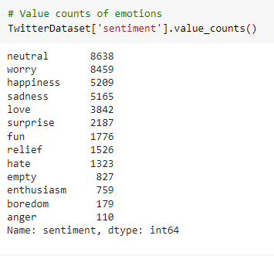
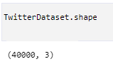
Dataset
https://www.kaggle.com/datasets/pashupatigupta/emotion-detection-from-text
tweet_emotions.csv
Notes:
The dataset we’re working with is a csv file we retrieved from Kaggle. It has three columns, tweet_id, sentiment, and content. And 40000 rows or tweets. Each tweet is assigned 1 of 13 sentiments. We’ll be using part of the content for training and part for testing for the machine learning models.

Slide 6
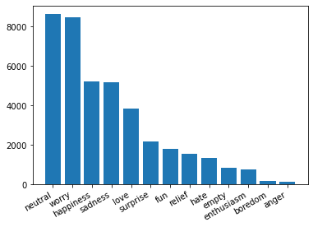
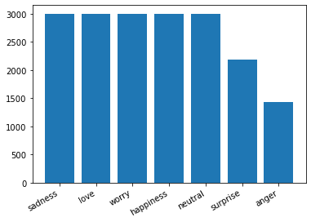
Preprocessing
Sentiments balancing
‘anger’ ⇔ ‘hate’
‘happiness’ ⇔ ‘fun’
Remove ‘relief’, ‘empty’, ‘enthusiasm’, and ‘boredom’
Cap all sentiments to a randomly selected 3k samples maximum
Notes:
The first thing we wanted to do is to reduce the number of sentiments. We combined anger and hate, happiness and fun, and removed ‘relief’, ‘empty’, ‘enthusiasm’, and ‘boredom’. So we trimmed the sentiments from 13 down to 7. We also wanted to cap all the sentiments to a randomly selected 3000 samples maximum. The reason for this is that this way we’ll have roughly the same number of samples per sentiment. If you look at the chart on the left, which was from the original dataset, the difference in sentiments is very large and this could yield bad results from the machine learning classifier. So we’re trying to balance the classes by capping the sentiments to 3000 samples.

Slide 7
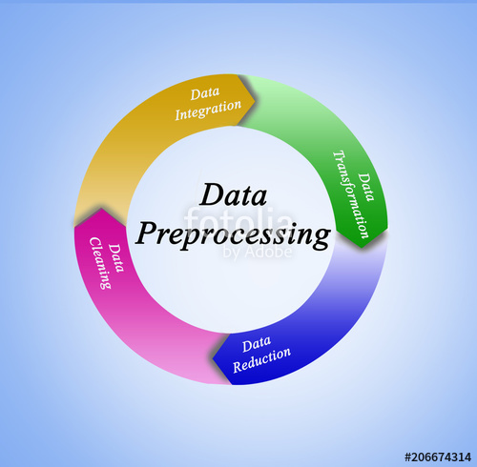
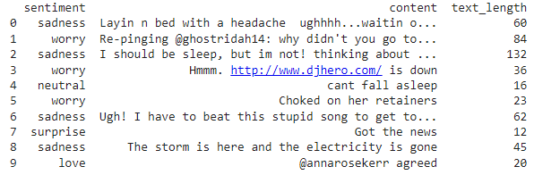
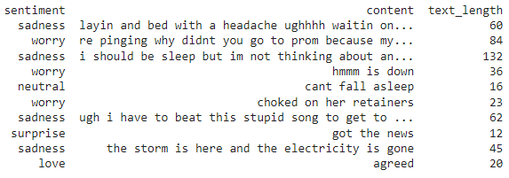
Preprocessing
Text Parsing
Make every word lower case
Remove nonsense characters
Non-alpha characters: numbers, punctuation, and other random characters
Usernames: starts with @
Websites: starts with http or www.
Stopwords
Tokenize each comment
Example:
Notes:
After some balancing, we’ll need to do some text parsing.

Slide 8
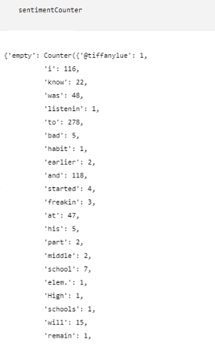
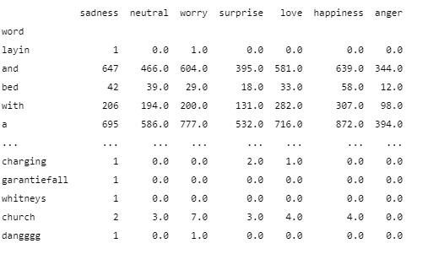
Preprocessing
Counting
Count up the number of instances of each word for each sentiment
Notes:
After handling the text parsing, we’re ready to put them in a counter. We counted up the number of instances of each word for each sentiment. The image on the right is an example of the counter we made. The dictionary’s keys are the 7 sentiments, and for each sentiment, there will be a counter of each word that appear in the sentiment. We then turned this counter dictionary into a dataframe so it can be better handled and used for the machine learning classifiers.

Slide 9
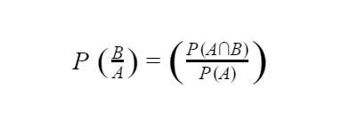
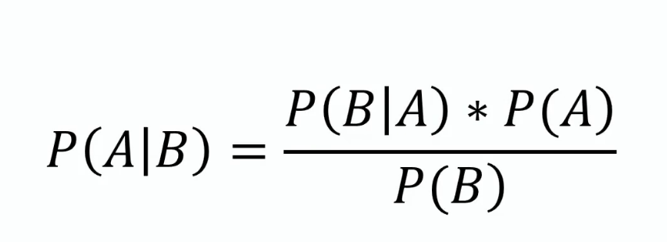
Naive Bayes’ Classifier
A Naive Bayes classifier is a probabilistic machine learning model which is used for classification. This classifier is based on the Bayes theorem.
The Multinomial Naive Bayes algorithm is a Bayesian learning approach popular in Natural Language Processing (NLP). The program guesses the tag of a text, such as an email or a newspaper story, using the Bayes theorem. It calculates each tag's likelihood for a given sample and outputs the tag with the greatest chance.

Slide 10
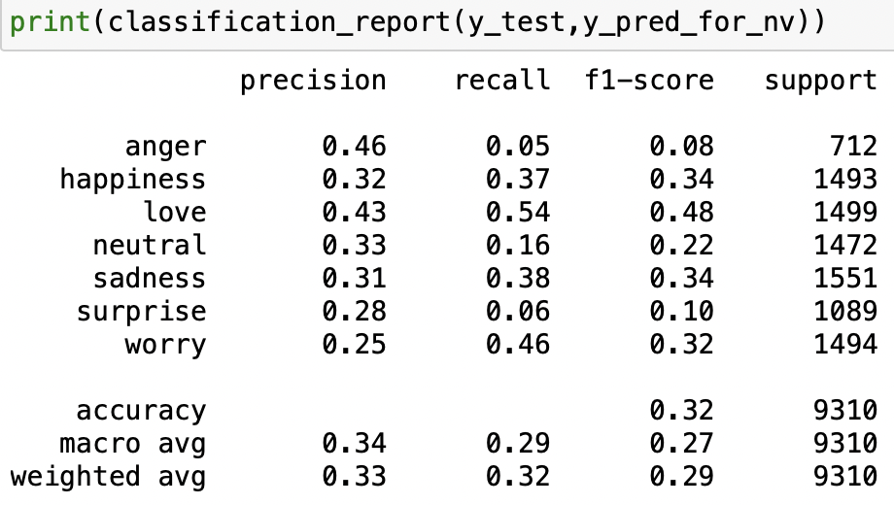
Naive Bayes’ Classifier
Results

Slide 11
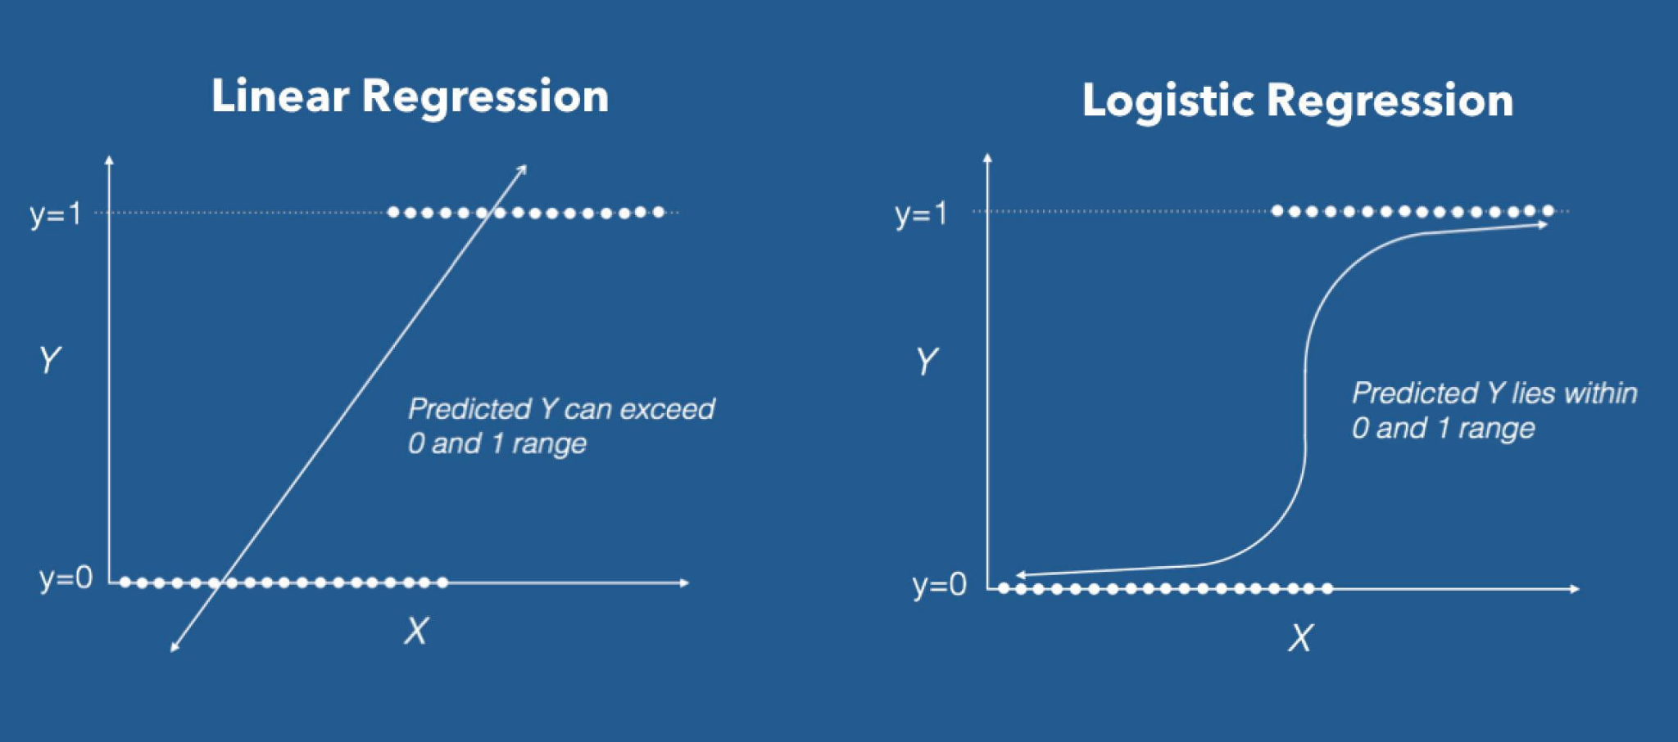
Logistic Regression Classifier
A logistic model is a statistical model that models the probability of one event taking place by having the log-odds for the event be a linear combination of one or more independent variables. In regression analysis, logistic regression estimates the parameters of a logistic model.

Slide 12
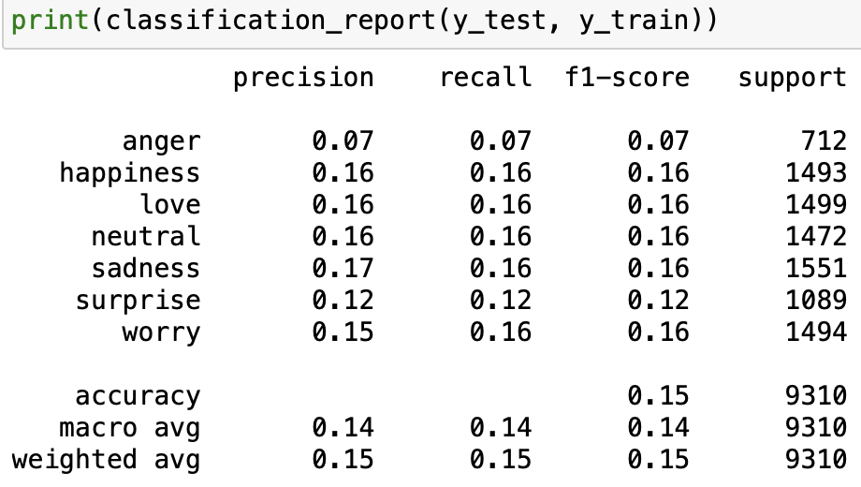
Logistic Regression Classifier
Results

Slide 13
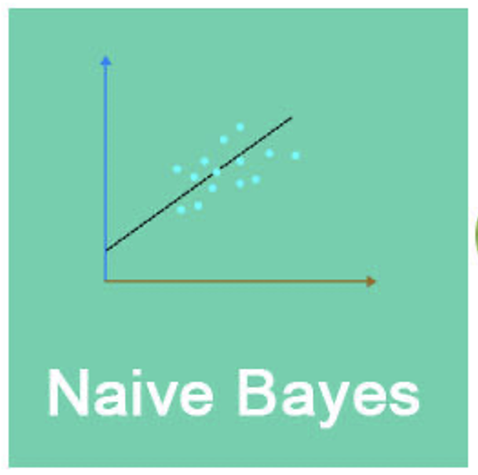

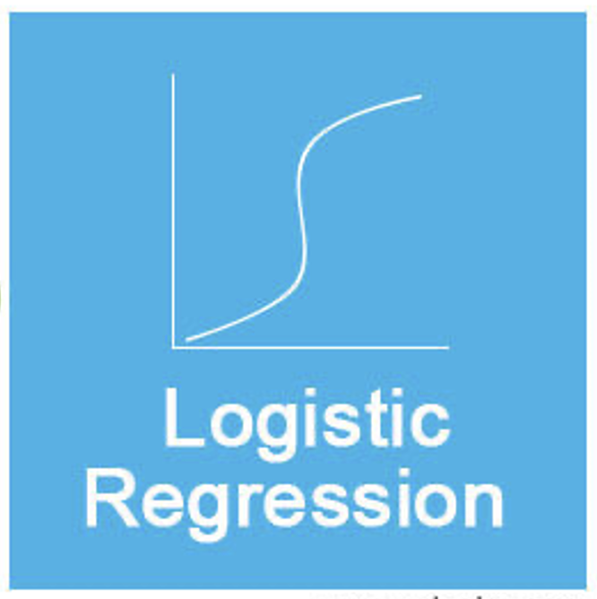
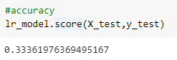
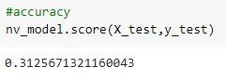
Naive Bayes’ vs. Logistic Regression
Naive Bayes
Log-linear classification model
Assumes independence
Higher bias and low variance
Closed form MLE
Logistic Regression
Log-linear classification model
Doesn’t assume independence
Low bias and higher variance
Gradient-based MLE

Slide 14
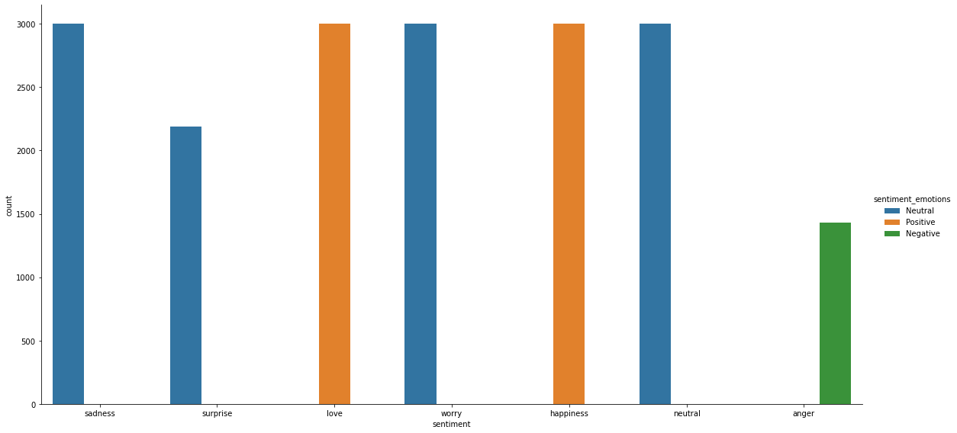
Textblob
Negative, neutral, positive

Slide 15
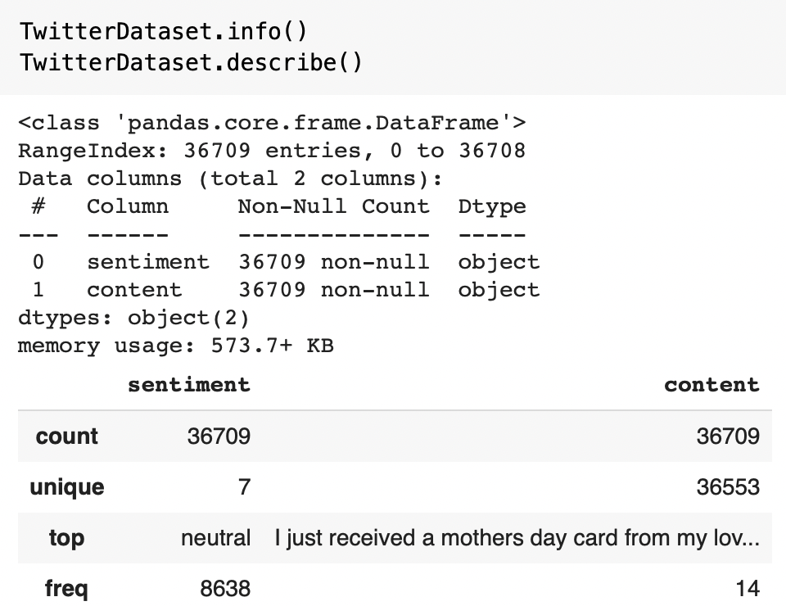
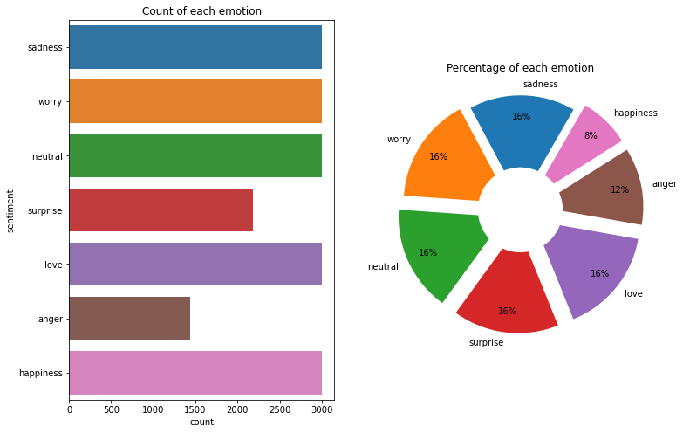
EDAs
EDA is applied to investigate the data and summarize the key insights. It will give you the basic understanding of your data, it's distribution, null values and much more. You can either explore data using graphs or through some python functions. There will be two type of analysis.

Slide 16
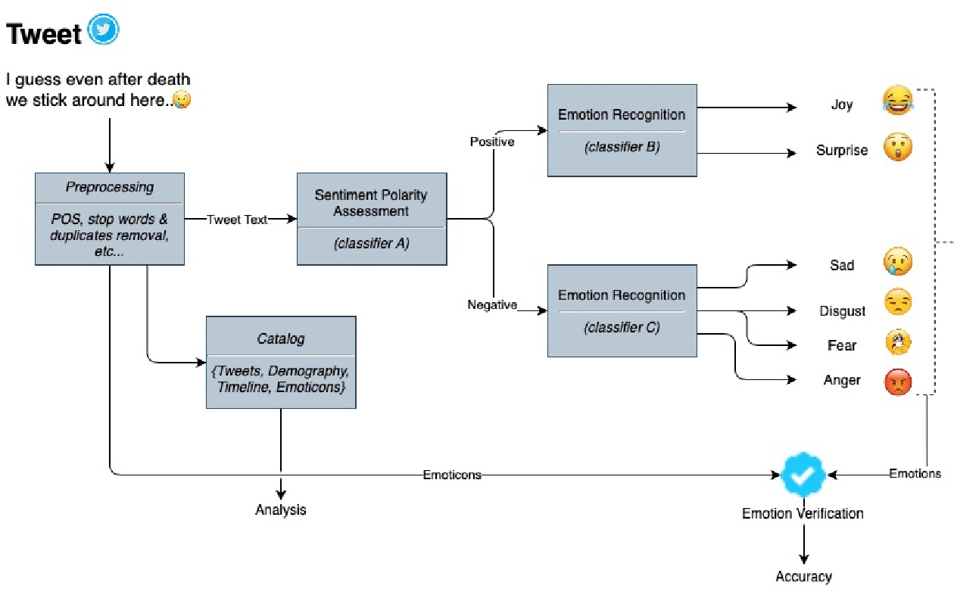

Slide 17

Conclusion
Emotion Detection can be seen as an important field of research in modern times in human-computer interaction. A sufficient amount of data has been collected by Kaggle to detect emotions from facial and audio information, whereas recognizing emotions from textual data is still a fresh and interesting thing in the computer world of data science.
In this project, modules and methods that are currently being used to detect emotions from text are reviewed along with their limitations, and a new system architecture is proposed, which would perform efficiently.

Slide 18


Team Members Work Distribution
Will Wu (ww437@drexel.edu)
Presentation Organization
Pre-processing
Mangesh Raut (mbr63@drexel.edu)
Presentation Organization
Machine Learning models
EDA Visualization
Josh Clark (jc4577@drexel.edu)
Usefulness of sentiments and class imbalance
Statistical model
Mobin Rahimi (mr3596@drexel.edu)
Project code organization
Readme.txt

